Slide 1
AI Innovators Capstone Project (DRAFT)
By Alex Temple and Seth Bickham

Slide 2
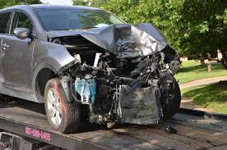
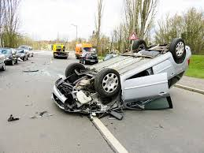
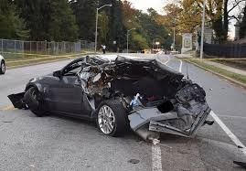
The Problem.
Motor vehicle accidents often leave victims unable to call for help, causing dangerous delays in emergency response.
Notes:
When a serious car crash occurs, the people inside the vehicle are often injured, disoriented, or unconscious—making it impossible for them to call 911. Traditional crash detection systems may be slow, may require manual activation, or may not provide enough detail for emergency responders to act quickly. As a result, emergency services can be delayed, which significantly increases the risk of severe injury or death. There is a need for an automated, reliable system that can instantly recognize a crash and contact authorities with accurate information, even when the occupants cannot.

Slide 3

The SOLUTION.
An AI-powered detection system that instantly identifies vehicle accidents and automatically alerts authorities to ensure rapid emergency response.
The system uses a mobile AI module that is in the car. The program monitors sensor data to detect crash-level impacts in real time. AI will continuously monitor sensor data (tracking sudden deceleration and impact force) to detect when a collision occurs.
Once detected, the system will automatically contact 911 with the vehicle’s location and crash details, ensuring rapid emergency response without requiring user action.
Notes:
Introducing the solution: Impact Intel

Slide 4



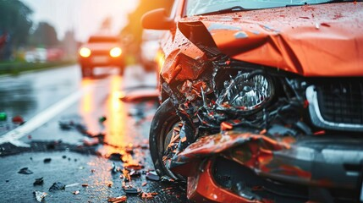
How it Works.
Notes:
How it work:
2. User is driving along
The driver is traveling normally, and the in-car AI continuously monitors sensor data in the background.
2. Crash detection
A sudden, severe impact occurs. The AI instantly recognizes the force pattern as a crash-level event.
3. Authorities are alerted
The system automatically sends an emergency alert to 911, including the vehicle’s GPS location and crash details—no user action needed.
4. Fast emergency service response
Emergency responders are dispatched quickly to the scene based on the automatically provided information, reducing response time and improving safety outcomes.

Slide 5

Type of AI.
Data:
Classification.
Sensor data will indicates a crash or non-crash event.
Deceleration patterns, impact force, and acceleration.
Simulated tests. -> Real Life Data.
Notes:
AI will use Classification to advance its algorithm.
The AI will determine whether incoming sensor data indicates a crash or non-crash event.
The AI will analyze data such as deceleration patterns, impact force, and acceleration.
Training data:
AI can start off learning through a variety of patterns set up by simulated tests. When the AI is put into action, it can continue to learn through its experiences to improve and adapt.

Slide 6

Ethics
Ethical Problem:
What information would the AI send, and would the person be able to pick and choose beforehand what the AI has access to? Would it be necessary for the people inside to have to enter personal information, like their weight, blood/alcohol levels, and other information like that? These are topics that would need to be explored further.

Slide 7
Innovation.
Highlight what makes your solution unique and impactful.

Slide 8
Market
Target users and benefits.
Next steps or investment request.

Slide 9
Sources
Slide 3 (car crash images) - Adobe Stock Images
Slide 6 (data entry image) - istockphotos

